Slide 1
Department of Veteran Affairs (VA) Post-9/11 Transition and Case Management Optimizing Care Transitions for Service Members from Department of Defense (DoD) to Veterans Health Administration (VHA)
Presented By:
Adrienne Weede, LCSW
National Program Manager, Post-9/11 Military2VA Case Management Program
Care Management and Social Work Services

Slide 2
Disclosure Statement
The views expressed in this presentation are those of the author and do not represent the official policy or position of VA or the United States Government.
The author has no conflict of interest to declare.

Slide 3
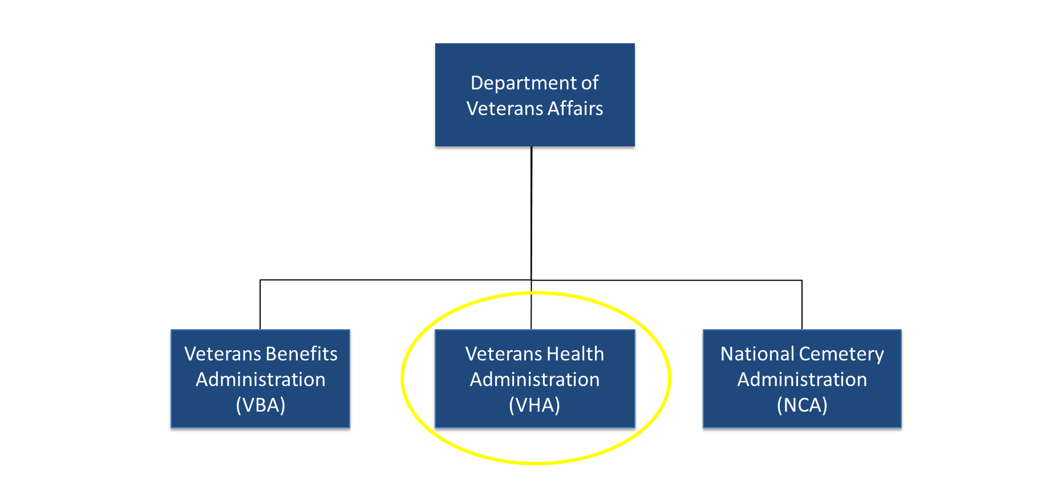
VA

Slide 4
History of Post-9/11 Transition and Case Management
VA Liaison Program established;
VA medical centers assign Points of Contact (POCs)
to receive referrals
Operation Enduring Freedom (OEF)/ Operation Iraqi Freedom (OIF) Transition Program established
Transition and Care Management Services (TCMS) Director position
established to oversee both VA Liaison and OEF/OIF/OND Programs
TCMS Co-Leads Care Coordination Initiative with Office of Nursing Services
TCMS renamed Post-9/11 Transition and Case Management and TCM renamed Post-9/11 Military2VA Case
Management (M2VA CM)
2005
2010
2016
2019
2003
2007
2015
2017
2021
VA Office of Seamless Transition established
OEF/OIF/Operation New Dawn (OND) Transition
Program Renamed
OEF/OIF/OND Transition Program renamed Transition and Care Management (TCM) Program
VA Liaison Program approved for Joint Incentive Funds for virtual VA Liaisons

Slide 5
Post-9/11 Transition and Case Management Overview
VA Liaison Program
43 VA Liaisons for Health Care at 21 Military Treatment Facilities (MTFs)
Post-9/11 M2VA CM
Located at each VA medical center
140 Program Managers
400+ Case Manager(s)
100+ Transition Patient Advocate
5 VA Liaisons to virtually support other DoD installations
Strategic Partnerships
4 VA Liaisons at Warrior Care Network Academic Medical Centers
0.5 VA Liaison at Marcus Institute for Brain Health (MIBH)
1 VA Liaison supporting 5 Avalon Action Alliance sites

Slide 6
Post-9/11 era Veteran Population Data & Demographics
Nearly 4 million Veterans are from the Post-9/11 era
More than 32% use VA health care
43% have a service-connected disability
An estimated 75% are under the age of 44 years; average age is about 37 years
More diverse than other military service eras
Elevated risk of suicide among Post-9/11 Veterans is associated with recent military separation

Slide 7
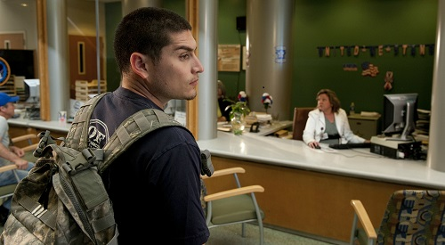
Post-9/11 era Veteran Health Care Transition Experience
"Doubts" (Narrative Training Video for the U.S. Dept. of Veterans Affairs)
7

Slide 8
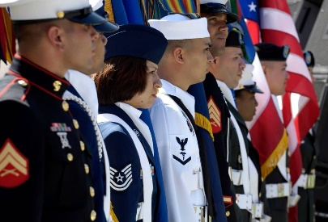
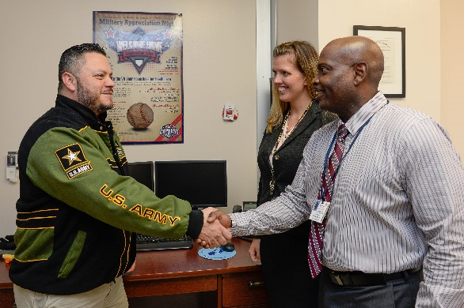
Making the Connection Between the DoD Community and VA Health Care
VA Liaison Program:
VA Liaisons for Healthcare are on site and virtually coordinating health care for transitioning service members at MTF and Veterans transferring from partnership sites.
VA Liaisons have transitioned over 145,000 service members/Veterans since the program inception.
In fiscal year (FY) 2022, 99% of those wanting a VA health care appointment received one; 97% attended their first appointment
Post-9/11 M2VA CM Program:
Teams are embedded in all VA medical centers and serve transitioning service members and Post-9/11 Veterans.
In FY 2022, 208,000+
Post-9/11 era Veterans were screened for case management;
38,000+ Post-9/11 era Veterans received ongoing case management services.
8

Slide 9
VA Liaisons for Healthcare

Slide 10
Connecting with a VA Liaison for Healthcare
Service Members Who Could Benefit from Assistance with Health Care Transition:
Severely ill/injured service members
Integrated Disability Evaluation System (IDES)/Medical Evaluation Board (MEB)
Release From Active Duty (REFRADS)
Transitioning service members with health care needs (e.g., mental health, chronic pain, toxic exposures)
Administrative separations (regardless of type) who need care coordination or education regarding VA
Expiration Term of Service (ETS) who will need ongoing care upon discharge
Any transitioning service member who requests assistance with post-military separation plans

Slide 11
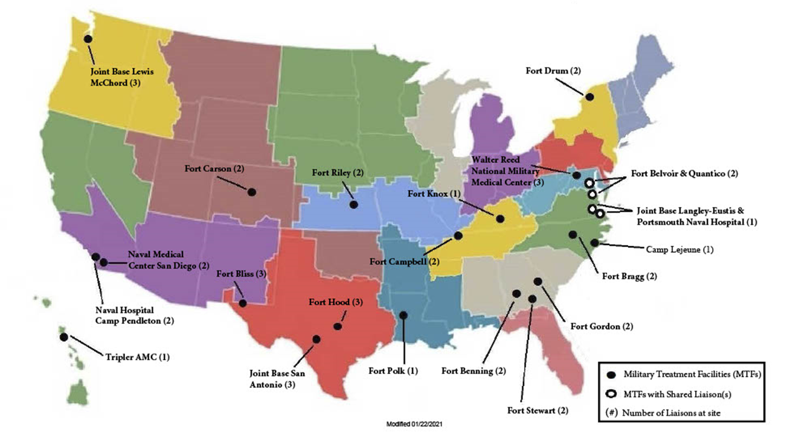
VA Liaisons for Healthcare Onsite at MTFs

Slide 12
Virtual Liaisons for Healthcare (Regional Map)
Region 1
ME, VT, MA, NH, RI, CT, NY, NJ, DE, PA, MD, WV, DC, NC, VA, SOCOM
Region 5
AK, ID, OR, WA, PH, HI, CA, NV, NM, AZ, and Guam
Region 1
Region 3
Region 2
GA, AL, SC, FL, PR, KY, TN, Virgin Islands, and Europe
Region 4
Region 2
Region 5
Philippines
Guam
Hawaii
Region 4
LA, MS, AR, TX, MT, WY, CO, OK and UT
Region 3
OH, MI, WI, IN, IL, MO, KS, ND, SD, MN, NE, and IA
American Samoa
Virgin Islands
Puerto Rico
Region 1
Region 3
Region 2
Region 4
Region 5

Slide 13
VA Liaisons Serving Public-Private Partnerships
Post-9/11 Transition and Case Management has Memoranda of Agreement (MOA) for the public-private partnerships with the Wounded Warrior Project (WWP) and the MIBH
MOA with the WWP for the Warrior Care Network
Partnership began in February 2016
MOA with the MIBH
Partnership began January 2019
Planned amendment to include additional sites within the Avalon Action Alliance

Slide 14
VA Liaisons for Healthcare: Public-Private Partnerships
Massachusetts General Hospital, Home Base (1)
Rush University Hospital, Road Home Program (1)
Moss Rehab Institute for Brain Health (0.20)
Marcus Institute for Brain Health (MIBH) (0.5)
UNC Chapel Hill Transforming Health & Resilience in Veterans (THRIVE) (0.20)
UCLA Health, Operation Mend (1)
Shepherd Center SHARE Military Initiative (0.20)
Emory Healthcare Veterans Program (1)
University of Florida Health Jacksonville (0.20)
Warrior Care Network
Avalon Network
Number of VA Liaisons at each site in ( )
Tulane University Center for Brain Health (0.20)
Modified 9/7/2022
Internal VA Use Only

Slide 15
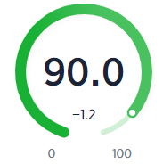
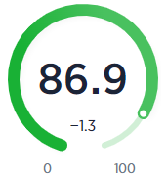
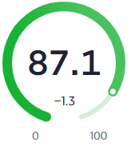
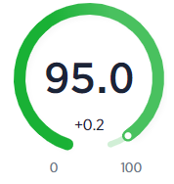
“Vsignals” – Veteran Experience Survey Summary
Overall Confidence/Trust
My Interaction with the VA
Program helped build my trust in VA
After working with the VA Liaison, I feel
more confident that I will receive the care I
need from VA
I am satisfied with how the VA Liaison
was able to coordinate my care

Slide 16
VHA Transition and Reintegration Support through Collaboration
Text
Pre-Military Separation
Time of Separation
Post-Military Separation
VA Liaison Program Post-9/11 M2VA CM Program
Collaboration between transition programs improves transitioning service members and recently separated Veterans experience as well as their access to care, services, and benefits.

Slide 17
Post-9/11 M2VA CM Teams
Post-9/11 M2VA Program Manager:
Provides program oversight and serves as POC for DoD, VHA, VBA
Ensures that transitioning service members and Post-9/11 era Veterans receive seamless care transitions that are tailored to their unique needs
Post-9/11 M2VA Case Manager:
Proactively screens all new transitioning service members and Post-9/11 era Veterans for case management for early identification of risk factors
Serves as Lead Coordinator to ensure safe transitions between DoD, VHA, and community and create a care plan that is holistic and integrated
Post-9/11 M2VA Transition Patient Advocate:
Serves as an advocate to help transitioning service members and Post-9/11 era Veterans, their families, and caregiver navigate the VA and access services, benefits and resources
Organizes and participates in outreach activities with VA, DoD, and community organizations

Slide 18
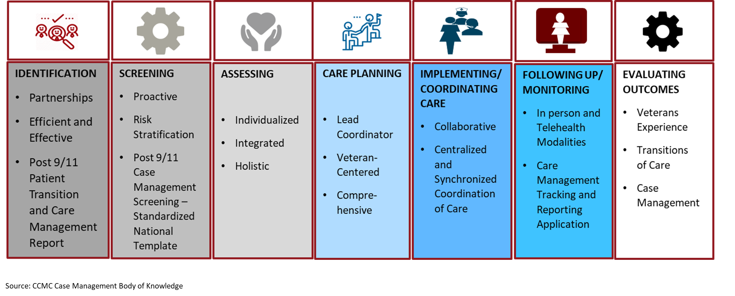
Post-9/11 M2VA CM Process

Slide 19
VA Post-9/11 M2VA Process Step: Identification

Slide 20
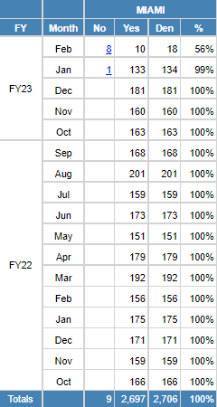
VA Post-9/11 M2VA Process Step: Identification
Post-9/11 Patients Transition & Care Management Report - Summary
Example VA Facility
Nationally standardized approach to identify transitioning service members and Post-9/11 era Veterans who are new to each VA health care system
Equips M2VA teams with ability to identify Veterans in near real time for proactive screening
Improved efficiency, accuracy, and validity of data collection
Increased awareness of Post-9/11 era Veterans who are new to the VA health care system

Slide 21
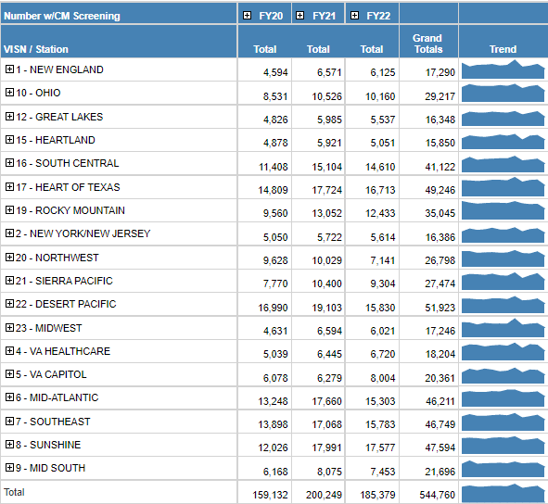
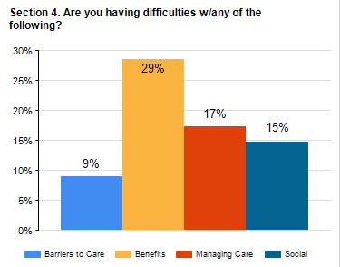
VA Post-9/11 M2VA Process Step: Screening
National Post-9/11 Case Management Screening Note Template
National standardization of screening for case management needs among transitioning service members and Post-9/11 era Veterans:
Linked to Post 9/11 Patient Case Management Report
Ability to stratify risk
Trend data based on health factors within screening
Increased awareness of Post-9/11 era Veteran needs

Slide 22
VA Post-9/11 M2VA Process Step: Assessment

Slide 23
VA Post-9/11 M2VA CM Process
Post-9/11 Patient Transition and Case Management Report
----------------------
Identifies all transitioning service members and Veterans new
to a facility
National Post-9/11
Case Management Screening
----------------------
208,350 Veterans Screened in FY22
Identification
Lead Coordinator Assignment and Individualized, Holistic Care Planning
----------------------
38,719 Veterans Accessed Lead Coordinator Services in FY 2022
Screening
Source: Post-9/11 Screening Report and
Care Management Tracking and Recording Application

Slide 24
VA Post-9/11 M2VA Process Step: Care Planning

Slide 25
Transitioning Your Health Care to VA: Things to Know
To transition your health care to VHA:
Establish a VA medical facility POC:
Connect with your local VA medical facility Post-9/11 M2VA CM Program
Do not make assumptions about your eligibility:
Enrollment and Eligibility offices are the subject matter experts and will verify your eligibility
To enroll, you must complete VA Form 10-10EZ
Apply online, by phone, mail or in person
Even the most prepared new Veteran will run into unforeseen challenges
Be proactive; ask questions
Connect to those who have gone before you

Slide 26
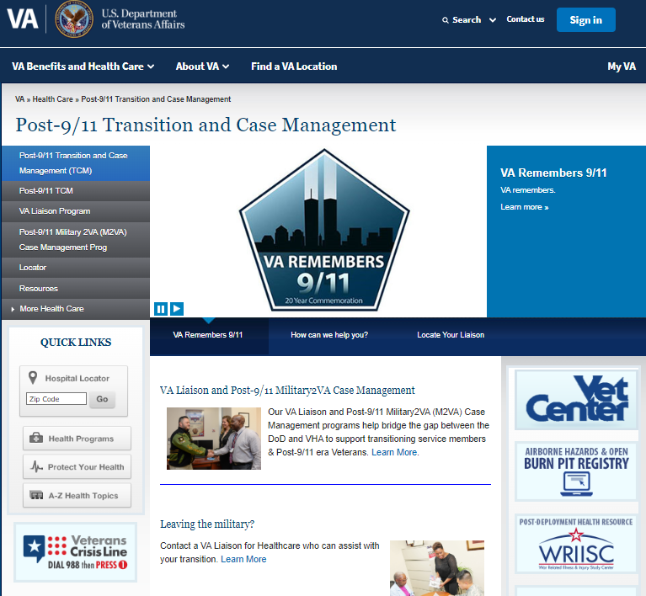
Points of Contact
Post-9/11 Transition and Case Management:
https://www.va.gov/post911veterans
A list and map of Post-9/11 M2VA CM Teams can be accessed here:
https://www.va.gov/POST911VETERANS/Locator.asp

Slide 27
Contacts
Jennifer Perez, LICSW
National Director, Post-9/11 Transition and Case Management
202-557-9033
Jennifer.Perez@va.gov
Kathy Dinegar, LICSW
National Program Manager, VA Liaison Program
202-679-6827
Kathleen.Dinegar@va.gov
Adrienne Weede, LCSW
National Program Manager,
Post-9/11 M2VA CM Program
520-260-0084
Adrienne.Weede@va.gov

Slide 28
Discussion
Do you have any questions?

Slide 29
References
Vogt, D.S., Tyrell, F.A., Bramande, E.A., Nillni, Y.I., Taverna, E.C., Finley, E.P., Perkins, D.F., Copeland, L.A.. U.S. Military Veterans’ Health and Well-Being in the First Year After Service. American Journal of Preventive Medicine, 2020; Mar;58(3):352-360. http://dx.doi.org/10.1016/j.amepre.2019.10.016.
Blosnich, J.R., Montgomery, A.E., Dichter, M.E. et al. Social Determinants and Military Veterans Suicide Ideation and Attempt: A Cross-sectional Analysis of Electronic Health Record Data. Journal of General Internal Medicine, 35, 1759-1767 (2020); https://link.springer.com/article/10.1007/s11606-019-05447-z.
Military –to-Civilian Readiness: The Past, Present and Future of the Transition Process. (2019) The MITRE Corporation. https://benefits.va.gov/TRANSITION/docs/military-to-civilian-readiness.pdf.
Healthy People 2030, U.S. Department of Health and Human Services, Office of Disease Prevention and Health Promotion. Retrieved April 13, 2021, from https://health.gov/healthypeople/objectives-and-data/social-determinants-health.
Garin, T., O’Toole, T., Uchendu, U. (2017, March 30). Focus on Health Equity and Action: Incorporating Social Determinants of Health into VHA Patient Care and Electronic Health Records [PowerPoint slides]. VHA Office of Health Equity, Department of Veterans Affairs. https://www.hsrd.research.va.gov/for_researchers/cyber_seminars/archives/2292-notes.pdf.
Ainspan, N. D., Penk, W., & Kearney, L. K. (2018). Psychosocial approaches to improving the military-to-civilian transition process. Psychological Services, 15(2), 129-134. http://dx.doi.org/10.1037/ser0000259.

Slide 30
References
Joint Economic Committee, 10 Key Facts About Veterans of the Post-9/11 Era [Fact Sheet]. U.S. Congress. jec-veterans-day-fact-sheet-2016.pdf (senate.gov).
Case Management Body of Knowledge, Commission for Case Manager Certification. https://cmbodyofknowledge.com/content/introduction-case-management-body-knowledge.
Veterans Health Administration (2019). Office of Mental Health and Suicide Prevention. National Veteran Suicide Prevention Annual Report, https://www.mentalhealth.va.gov/docs/data-sheets/2019/2019_National_Veteran_Suicide_Prevention_Annual_Report_508.pdf.
Wasiak, D., Holmes, A.M. The Unique Health Needs of Post-9/11 U.S. Veterans. Workplace Health and Safety, 2017; DOI link: https://doi.org/10.1177/2165079916682524.
U.S. Department of Labor. (2021, March 18). Employment Situation of Veterans—2020 [Press Release]. https://www.bls.gov/news.release/pdf/vet.pdf
Kang, H.K., et al. Suicide risk among 1.3 million veterans who were on active duty during the Iraq and Afghanistan wars. Ann Epidemiol. 2015 Feb;25(2):96-100. https://doi.org/10.1016/j.annepidem.2014.11.020

