Slide 1
The Truth Is Out There!
Social Support Programs in the Military: They DO Exist!
Military Social Work & Behavioral Health Conference Austin, Texas 12 June 2023
Zona T. Lewis Director, Military Community Outreach DOD, Military Community & Family Policy

Slide 2
DEPARTMENT OF DEFENSE
MilSpouse
31+
years
DIRECTOR
Military Community Outreach
Zona T. Lewis
Cardboard Crafter

Slide 3
Today’s Mission
Bust the myth that social support programs don’t exist by exploring a couple of MilLife stressors and identify Department of Defense programs, resources, and information that assist service members and their families address thrive.
and/or
Background Check
Review terms the Department of Defense uses define and identify social support programs in the military.
The Investigation
Demonstrate the existence of social support programs in the military through two+ “case” investigations.
The Interrogation
I will answer your questions about social support programs in the military.
Your Mission
…should you choose to accept it.

Slide 4
Background Check - Definitions
The following are definitions the Department of Defense uses to define support in the context of the military family readiness system.
Military Family Well-Being
The ability of individuals and families to maintain positive outcomes across the domains of career, social, financial, health, and community engagement.
Military Family Readiness
The state of being prepared within the unique context of military service, to effectively navigate the challenges of daily living and military transitions.
Military Family Resilience
The ability of individuals and families to withstand, recover from, and grow in the face of stressors and changing demands of military life to maintain positive outcomes across the domains of career, social, financial, health, and community engagement.
The degree to which service members and their families feel positively attached to the military as an organization and view the military community as a source of support and connection to others.
Sense of Community
Source: DoD Instruction 1342.22 Military Family Readiness, August 5, 2021: https://www.esd.whs.mil/Portals/54/Documents/DD/issuances/dodi/134222p.pdf?ver=gd2jijkfOgIW7hQpQYHWCQ%3d%3d

Slide 5
Background Check – Programs
The following are definitions the Department of Defense uses to define support in the context of the military family readiness system.
Quality of Life Programs
Military Family Readiness Programs
DOD quality of life programs include commissaries; family readiness, support, and well-being, including child and youth services, family advocacy, spouse employment, and family members with special needs; chaplaincy; allowances; community services; dependents’ education; morale, welfare, and recreation programs; special events; lodging; and nonappropriated fund instrumentalities, including supplemental mission funds and special purpose central funds.
Services that address the needs resulting from the unique challenges associated with military lifestyle, including, but not limited to personal and family life readiness, financial readiness, mobilization and deployment, and relocation. The domains include career, social, financial, health and community. Services include Relocation Assistance, Non-Medical Clinical Counseling, Personal and Family Life Education, Financial Readiness, Information and Referral services, Deployment Readiness, Employment Readiness, Exceptional Family Member Program services, Child Abuse Prevention services, Domestic Abuse Prevention and Response services, Problematic Sexual Behavior in Children and Youth response services, MWR services, Emergency Family Assistance, and Transition Assistance.
Sources: DoD Directive 5124.10, March 14, 2018: https://www.esd.whs.mil/Portals/54/Documents/DD/issuances/dodd/512410p.pdf?ver=2018-03-15-115410-923
DoD Instruction 1342.22 Military Family Readiness, August 5, 2021: https://www.esd.whs.mil/Portals/54/Documents/DD/issuances/dodi/134222p.pdf?ver=gd2jijkfOgIW7hQpQYHWCQ%3d%3d

Slide 6
You Decide
Plan A
Plan B
Investigate the two pre-determined “cases”
Service provider specific resources
Q&A session
Your Mission
Skip the two pre-determined “cases”
Quick overview of service provider specific resources
Jump into Q&A session
You Mission

Slide 7
Plan A

Slide 8
CASE #1: THE SQUEEZE
According to the DoD’s 2020 Status of Forces Survey of Active-Duty Members:
24% of active-duty military experienced some level of food insecurity in 2020, with 14% reporting low food security and 10% reporting very low food security.
Junior enlisted service members are at the highest risk for food insecurity at 29%.
In a 2020 Harris Interactive poll, 54% of service members said that “just getting by financially” describes them completely or very well.
1
Source: 2020 Status of Forces Survey of Active-Duty Members https://www.militaryonesource.mil/data-research-and-statistics/survey-findings/status-of-forces-survey/

Slide 9
Food Security Support Programs & Resources
The Defense Department offers a variety of programs, tools, and resources to increase and bolster the economic security and food security of service members and families needing immediate relief, planning ahead to reach their goals, and to secure their financial well-being.
Financial Calculators
MilTax
Sen$e App
Financial Counseling Services
Military Installation Financial Readiness Programs
Military OneSource Financial Counseling
Military & Family Life Counseling Personal Financial Counselors
Commissary
MilSpouse Money Mission®
Sources: Military OneSource’s Resources for Financial Stress - https://www.militaryonesource.mil/financial-legal/personal-finance/military-financial-stress-resources/
The Office of Financial Readiness - https://finred.usalearning.gov/
The Defense Commissary Agency - https://www.commissaries.com/stronger-together

Slide 10
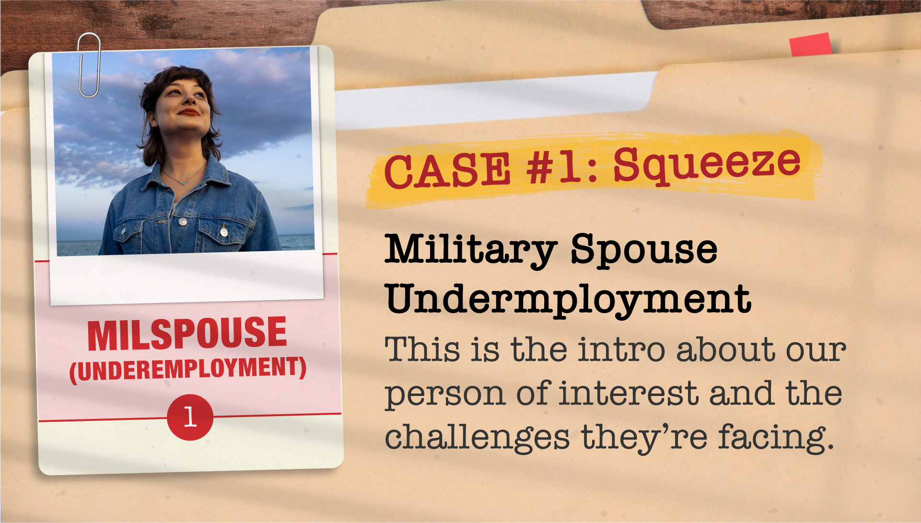
CASE #2: THE QUAGMIRE
According to the DoD’s Active-Duty Spouse Survey:
There was no significant change in the unemployment rate for civilian spouses (21%) back to 2015.
Caring for children not in daycare or school was the main reason spouses were not working at the time of the survey.
Over half of active-duty spouses worked for an employer that offered flexible scheduling.
A PCS move, especially in the past 12 months, increased the odds of unemployment significantly.
2
Source: 2021 Active-Duty Spouse Survey https://www.militaryonesource.mil/data-research-and-statistics/survey-findings/2021-spouses-survey/

Slide 11
Spouse Employment Support Programs & Resources
The Defense Department offers a variety of programs, tools, and resources to provide education and career guidance to military spouses to help them achieve their education and employment goals.
Spouse Education & Career Opportunities
-SECO-
Military Spouse Employment Partnership
-MSEP-
My Career Advancement Account
-MyCAA-
LinkedIn Premium
Military Spouse Scholarship Lookup Tool
Military Spouse Transition Program
- MySTeP-
Sources: Spouse Education & Career Opportunities – SECO - https://myseco.militaryonesource.mil/portal/ Military Spouse Employment Partnership – MSEP - https://msepjobs.militaryonesource.mil/msep/ My Career Advancement Account - MyCAA - https://mycaa.militaryonesource.mil/mycaa/
LinkedIn Premium Upgrade -https://myseco.militaryonesource.mil/portal/article/linkedin-premium-for-military-spouses
Military Spouse Scholarship Lookup Tool - https://myseco.militaryonesource.mil/portal/scholarships
Military Spouse Transition Program – MySTeP - https://myseco.militaryonesource.mil/portal/mystep

Slide 12
Plan B

Slide 13
SERVICE PROVIDERS

Slide 14
Service Provider Resources
The Defense Department offers a variety of resources, tools and information to support those who are supporting the military community.
Community Resource Finder
Taking Care of Service Members & Families
Economic Security Toolkit for Military Leaders
Military OneSource Call Center
Military OneSource Website
eNewsletters for Service Provider
Sources: Community Resource Finder - https://www.militaryonesource.mil/confidential-help/non-medical-counseling/military-onesource/connect-people-to-services-faster-with-the-community-resource-finder/ Taking Care of Our Service Members and Families - https://www.militaryonesource.mil/financial-legal/personal-finance/taking-care-of-people/
Economic Security Toolkit for Military Leaders - https://www.militaryonesource.mil/leaders-service-providers/economic-security/
Military OneSource Call Center – (800) 342-9647
Military OneSource Website Service Provider and Leaders Section - https://www.militaryonesource.mil/leaders-service-providers/
Military Financial Service Provider eNewsletter - https://finred.usalearning.gov/ePublications
MilProvider eNewsletter - https://www.militaryonesource.mil/epublications/

Slide 15
Service Provider Resources continued…
The Defense Department offers a variety of resources, tools and information to support those who are supporting the military community.
MilProvider App
Resource Request System
National Resource Directory
Training
Military OneSource Podcasts
Sources: National Resource Directory - https://www.nrd.gov/ Resource Request System - https://supportrequest.militaryonesource.mil/
MilLife Learning – https://millifelearning.militaryonesource.mil/
OneOp - https://oneop.org/
Virtual Lab School - https://www.virtuallabschool.org/ Military OneSource Podcasts - https://www.militaryonesource.mil/resources/podcasts/

Slide 16
Service Provider Resources continued…
The Defense Department offers a variety of resources, tools and information to support those who are supporting the military community.
Military OneSource Website’s Data, Research, & Statistics Section
RAND
Research Reports
JAMRS
Office of People Analytics
Military Family Life Project
Military REACH
Preventing Suicide in the U.S. Military
Strengthening the Military Family Readiness System Consensus Study Report
Sources: Data, Research and Statistics landing page on MilitaryOneSource.mil - https://www.militaryonesource.mil/data-research-and-statistics/
RAND Research Reports - https://www.rand.org/topics/military-families.html
Joint Advertising, Market Research & Studies - https://jamrs.defense.gov/
Office of People Analytics - https://www.opa.mil/
Military Family Life Project - https://download.militaryonesource.mil/12038/MOS/Reports/MFLP-Longitudinal-Analyses-Report.pdf
Military REACH- https://militaryreach.auburn.edu/Redirect
Preventing Suicide in the U.S. Military - https://www.defense.gov/News/Releases/Release/article/3309738/suicide-prevention-and-response-independent-review-committee-sprirc-releases-re/
National Academies of Sciences, Engineering, Medicine’s 2019 Strengthening the Military Family Readiness System Consensus Study Report – http://nap.nationalacademies.org/25390

Slide 18
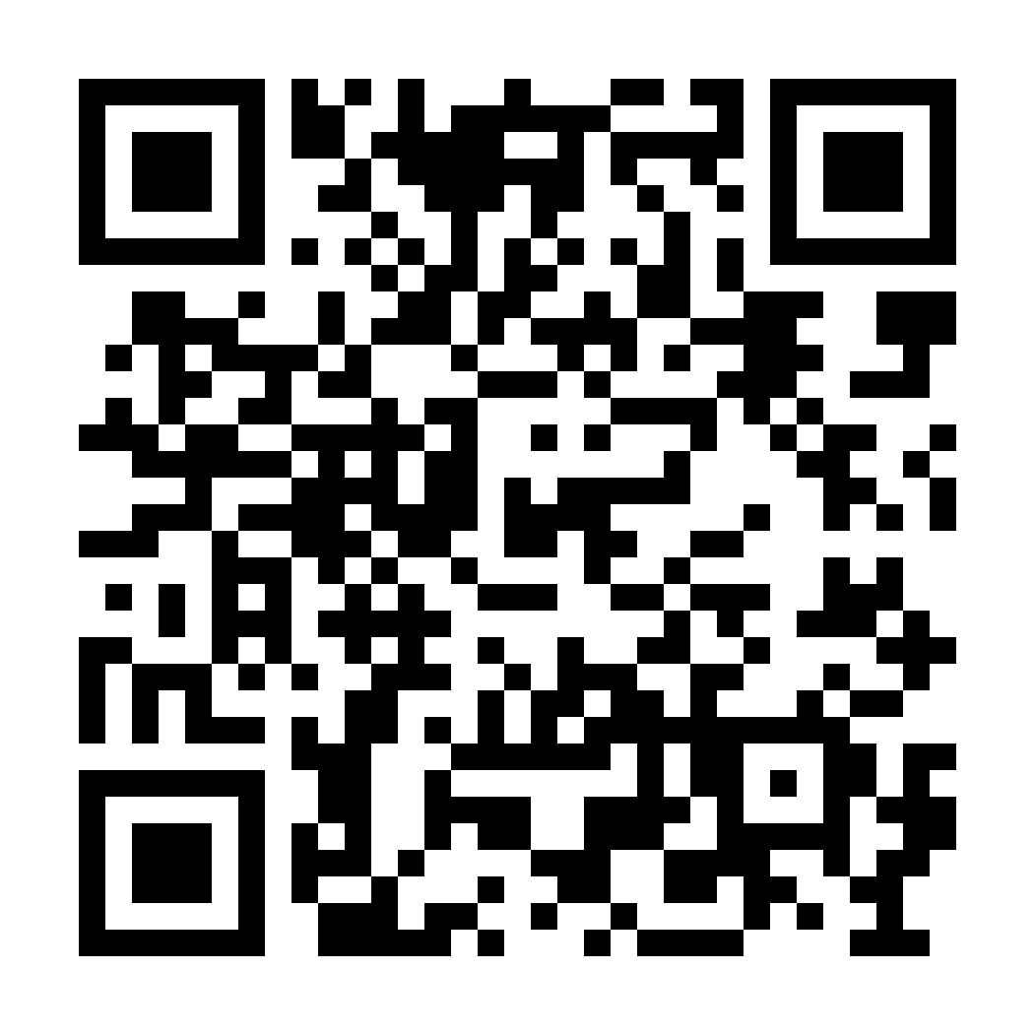
Your Mission
Take a picture of this QR Code
or visit https://militaryonesource.mil/social-work-behavioral-health-conference
for all the information presented today AND more!

Slide 19
Zona T. Lewis
Director, Military Community Outreach
Military Community & Family Policy
Office: 703.697.2476
zona.t.lewis.civ@mail.mil
“Connecting you to your best MilLife” www.militaryonesource.mil | 1-800-342-9647

